Slide 1
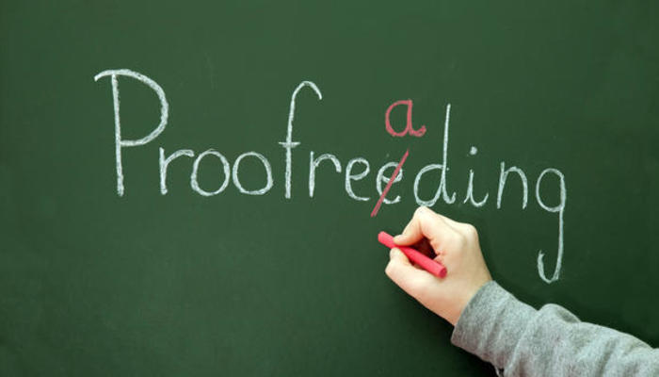
Proofreading

Slide 2

Proofreading finds mostly typing errors.
These errors may affect meaning.

Slide 3
Call me Pat.
Call me, Pat.
I’m sorry I love you.
I’m sorry. I love you.

Slide 4
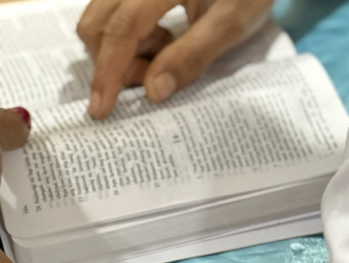
Correct typing and format are evidence of a quality translation.

Slide 5
From Galatians 5:
22But the fruit OF the spirit is love joy) peace, patience, Kindness, goodness, Faith, gentleness, and selfcontrol against such things there is no law . 24 those who belong to christ Jesus have cRucified the flesh with its passionsa nd desires²⁵ If we live by the Spirit, let us also walk” by thespirit?
²² But the fruit of the Spirit is love, joy, peace, patience, kindness, goodness, faith, ²³ gentleness, and self-control; against such things there is no law. ²⁴ Those who belong to Christ Jesus have crucified the flesh with its passions and desires. ²⁵ If we live by the Spirit, let us also walk by the Spirit.

Slide 6
From Galatians 5: Proper Number of Verses
22But the fruit OF the spirit is love joy) peace, patience, Kindness, goodness, Faith, gentleness, and selfcontrol against such things there is no law . 24 those who belong to christ Jesus have cRucified the flesh with its passionsa nd desires²⁵ If we live by the Spirit, let us also walk” by thespirit?
²² But the fruit of the Spirit is love, joy, peace, patience, kindness, goodness, faith, ²³ gentleness, and self-control; against such things there is no law. ²⁴ Those who belong to Christ Jesus have crucified the flesh with its passions and desires. ²⁵ If we live by the Spirit, let us also walk by the Spirit.

Slide 7
Chapter Headings
Chapter One
¹ That which was from the beginning, which we have heard, which we have seen with our eyes, which we have looked at and our hands have touched, concerning the Word of life— ² the life was made known, and we have seen and testify and proclaim to you the eternal life, which was with the Father, and which has been made known to us. ³ That which we have seen and heard we declare also to you, ...
1 JOHN 2
¹ Children, I am writing these things to you so that you will not sin. But if anyone sins, we have an advocate with the Father, Jesus Christ, the one who is righteous. ² He is the atoning sacrifice for our sins, and not for ours only, but also for the whole world. ³ We know that we have come to know him, if we keep his commandments. ⁴ The one who says "I know God" but does not keep his commandments ...
Chapter 2
¹ See what kind of love the Father has given to us, that we should be called children of God, and this is what we are. For this reason, the world does not know us, because it did not know him. ¹ ² Beloved, we are now children of God, and it has not yet been revealed what we will be. We know that when Christ appears, we will be like him, for we will see him just as he is. ³ Everyone who has this hope in him ...

Slide 8
From Galatians 5: Miscellaneous
22But the fruit OF the spirit is love joy) peace, patience, Kindness, goodness, Faith, gentleness, and selfcontrol against such things there is no law . 24 those who belong to christ Jesus have cRucified the flesh with its passionsa nd desires²⁵ If we live by the Spirit, let us also walk” by thespirit?
²² But the fruit of the Spirit is love, joy, peace, patience, kindness, goodness, faith, ²³ gentleness, and self-control; against such things there is no law. ²⁴ Those who belong to Christ Jesus have crucified the flesh with its passions and desires. ²⁵ If we live by the Spirit, let us also walk by the Spirit.

Slide 9

Read Aloud

Slide 10
From Galatians 5: Endings of Sentences
22But the fruit OF the spirit is love joy) peace, patience, Kindness, goodness, Faith, gentleness, and selfcontrol against such things there is no law . 24 those who belong to christ Jesus have cRucified the flesh with its passionsa nd desires²⁵ If we live by the Spirit, let us also walk” by thespirit?
²² But the fruit of the Spirit is love, joy, peace, patience, kindness, goodness, faith, ²³ gentleness, and self-control; against such things there is no law. ²⁴ Those who belong to Christ Jesus have crucified the flesh with its passions and desires. ²⁵ If we live by the Spirit, let us also walk by the Spirit.

Slide 11
From Galatians 5: Beginnings of Sentences
22But the fruit OF the spirit is love joy) peace, patience, Kindness, goodness, Faith, gentleness, and selfcontrol against such things there is no law . 24 those who belong to christ Jesus have cRucified the flesh with its passionsa nd desires²⁵ If we live by the Spirit, let us also walk” by thespirit?
²² But the fruit of the Spirit is love, joy, peace, patience, kindness, goodness, faith, ²³ gentleness, and self-control; against such things there is no law. ²⁴ Those who belong to Christ Jesus have crucified the flesh with its passions and desires. ²⁵ If we live by the Spirit, let us also walk by the Spirit.

Slide 12
From John 6: Quotation Marks
⁶⁷ Then Jesus said to the twelve, “You do not want to go away also, do you?” ⁶⁸ Simon Peter answered him, “Lord, to whom would we go? You have words of eternal life, ⁶⁹ and we have believed and come to know that you are the Holy One of God.”
⁶⁷ Así que Jesús preguntó a los doce:
—¿También ustedes quieren marcharse?
⁶⁸ —Señor —contestó Simón Pedro—, ¿a quién iremos? Tú tienes palabras de vida eterna. ⁶⁹ Y nosotros hemos creído, y sabemos que tú eres el Santo de Dios.

Slide 13
From Galatians 5: Quotation Marks
22But the fruit OF the spirit is love joy) peace, patience, Kindness, goodness, Faith, gentleness, and selfcontrol against such things there is no law . 24 those who belong to christ Jesus have cRucified the flesh with its passionsa nd desires²⁵ If we live by the Spirit, let us also walk” by thespirit?
²² But the fruit of the Spirit is love, joy, peace, patience, kindness, goodness, faith, ²³ gentleness, and self-control; against such things there is no law. ²⁴ Those who belong to Christ Jesus have crucified the flesh with its passions and desires. ²⁵ If we live by the Spirit, let us also walk by the Spirit.

Slide 14
From John 6: Parentheses
¹ After these things, Jesus went away to the other side of the Sea of Galilee, also called the Sea of Tiberias. ² A great crowd was following him because they saw the signs that he was doing on those who were sick. ³ Jesus went up the mountain and there he sat down with his disciples. ⁴ (Now the Passover, the Jewish festival, was near.) ⁵ When Jesus looked up and saw a great crowd coming to him, he said to Philip, "Where are we going to buy bread so that these may eat?" ⁶ (But Jesus said this to test Philip, for he himself knew what he was going to do.)

Slide 15
From Galatians 5: Parentheses
22But the fruit OF the spirit is love joy) peace, patience, Kindness, goodness, Faith, gentleness, and selfcontrol against such things there is no law . 24 those who belong to christ Jesus have cRucified the flesh with its passionsa nd desires²⁵ If we live by the Spirit, let us also walk” by thespirit?
²² But the fruit of the Spirit is love, joy, peace, patience, kindness, goodness, faith, ²³ gentleness, and self-control; against such things there is no law. ²⁴ Those who belong to Christ Jesus have crucified the flesh with its passions and desires. ²⁵ If we live by the Spirit, let us also walk by the Spirit.

Slide 16
From Galatians 5: Capitalization (Names and Places in English)
22But the fruit OF the spirit is love joy) peace, patience, Kindness, goodness, Faith, gentleness, and selfcontrol against such things there is no law . 24 those who belong to christ Jesus have cRucified the flesh with its passionsa nd desires²⁵ If we live by the Spirit, let us also walk” by thespirit?
²² But the fruit of the Spirit is love, joy, peace, patience, kindness, goodness, faith, ²³ gentleness, and self-control; against such things there is no law. ²⁴ Those who belong to Christ Jesus have crucified the flesh with its passions and desires. ²⁵ If we live by the Spirit, let us also walk by the Spirit.

Slide 17
From Galatians 5: Spelling of Common Words
22But the fruit OF the spirit is love joy) peace, patience, Kindness, goodness, Faith, gentleness, and selfcontrol against such things there is no law . 24 those who belong to christ Jesus have cRucified the flesh with its passionsa nd desires²⁵ If we live by the Spirit, let us also walk” by thespirit?
²² But the fruit of the Spirit is love, joy, peace, patience, kindness, goodness, faith, ²³ gentleness, and self-control; against such things there is no law. ²⁴ Those who belong to Christ Jesus have crucified the flesh with its passions and desires. ²⁵ If we live by the Spirit, let us also walk by the Spirit.

Slide 18
Proofreading: A Different Kind of “Looking”
One chapter at a time
One category at a time
Read out loud!
Mark the corrections
Correct spelling errors in common words
Mark the Checklist box when each category is completed
Chapter 5 26 verses
verse numbers
chapter number
spacing
read through aloud
ends of sentences
starts of sentences
pairs: ( ) “ ” [ ]
capitals on names
____________________
____________________

Slide 19
Try it

Slide 20


